Slide 1
Algothon BlackRock 2019
Alexandros Haliassos, Andreas Theodoulou, Kriton Konstantinidis, and Yao Lei Xu
Data: End of Day US Stock Prices (QUANDL), Global Supply Chain Relationships (QUANDL), Social Media Analytics (QUANDL), External Fundamental Data
Themes: Supply Chain (Main Theme) and Social Media Analytics
(No AWS Used)

Slide 2
Trading Universe
A-priori choice of S&P500
Liquidity/tradability
Data availability
Easier to manage
Reduced to ~200 stocks due to data compatibility

Slide 3
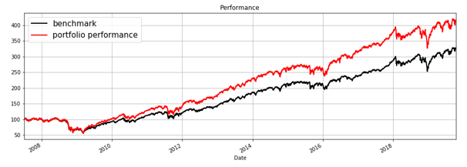
Factor Driven XGBoost
 | XGBoost
Average Validation Hit Ratio | 0.56
Hypothesis:
Exposure to classic factors, alpha
generation through non-linearities
and feature engineering
Strategy:
14 Style factors (Mom, Value, Quality, Size)
Feature Engineering (1M, 3M, 12M rate of change)
Regression against monthly returns, with CV-based turning every year
Strategy: Long-positive return predictions equally
 | Benchmark | XGB-EW
Return (annualized) | 11.92% | 13.96%
Sharpe | 0.61 | 0.68

Slide 4
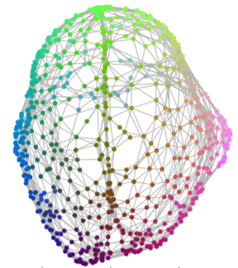
Graph Signal Processing Approaches
GSP-based methods have been gaining traction in the past few years [1-2]
Extensions of signal processing methods to irregular domains (e.g. social networks, geographical topologies, etc.)
Stocks and their relationships can be embedded in a graph-theoretic framework
[1] Shuman, D.I., Narang, S.K., Frossard, P., Ortega, A. and Vandergheynst, P., 2013. The emerging field of signal processing on graphs: Extending high-dimensional data analysis to networks and other irregular domains. IEEE signal processing magazine, 30(3), pp.83-98.
[2] Dees, B.S., Stankovic, L., Constantinides, A.G. and Mandic, D.P., 2019. Portfolio Cuts: A Graph-Theoretic Framework to Diversification. arXiv preprint arXiv:1910.05561.

Slide 5
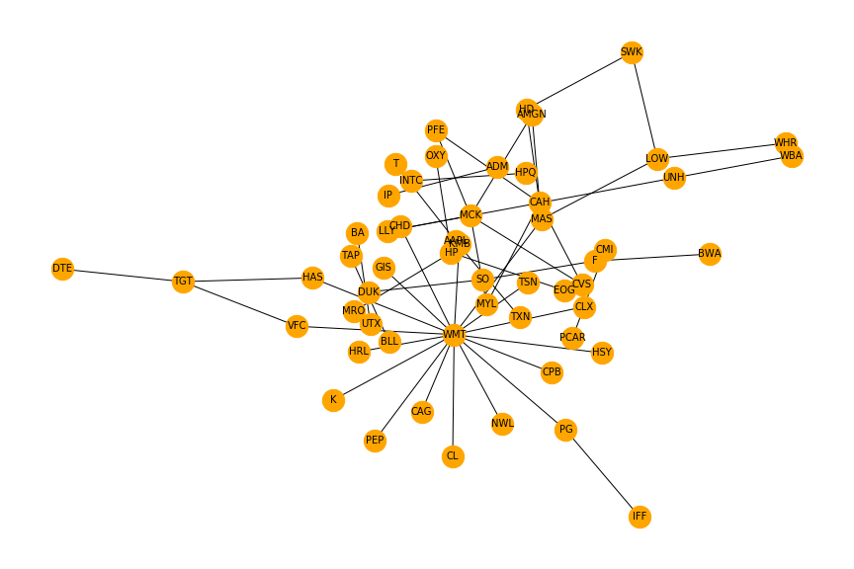
Structural Relationships
Graphs can model directed adjacency relationships among stocks (revenue dependency)
Nodes: Stocks
Edges: Derived revenue
Directed structural flow of information (supplier to customer)

Slide 6
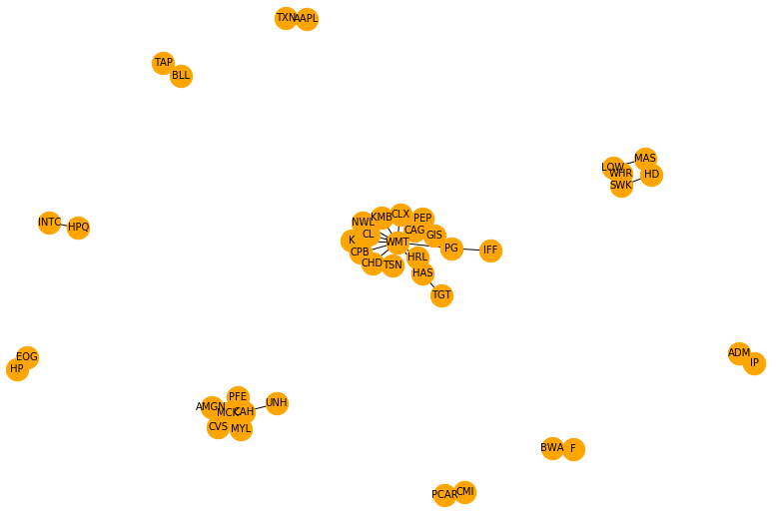
Topological Clustering
Hypothesis:
Structural exposure can be avoided by choosing limited stocks per cluster
Avoid end-of-chain stocks
Graph clustering of interconnected stocks based on business relationships
Highly interpretable
Applies universally

Slide 7
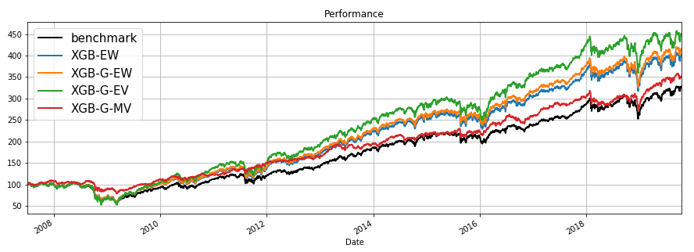
Performance Results
XGBoost Equally Weighted (XGB-EW)
XGB-EW with Graph Clustering (XGB-G-EW)
XGB-G-EW with equal volatility weights (XGB-G-EV)
XGB-G Minimum Variance weights (XGB-G-MV)
 | Benchmark | XGB-EW | XGB-G-EW | XGB-G-EV | XGB-G-MV
Return | 11.92% | 13.96% | 14.28% | 15.51% | 11.95%
Sharpe | 0.61 | 0.68 | 0.69 | 0.67 | 0.87

Slide 8
Orthogonal Strategies
Current process has high beta (long-only)
Would like strategies orthogonal to the market factor

Slide 9

Tensor Analysis
Tensors [3-4] have rich organisational structure and can be used to model high-dimensional data
They exploit multiple interactions and couplings in data that is not possible with the “flat-view” matrix approaches
Use Support Tensor Machine for financial data [5]
[3] Cichocki, A., Mandic, D., De Lathauwer, L., Zhou, G., Zhao, Q., Caiafa, C. and Phan, H.A., 2015. Tensor decompositions for signal processing applications: From two-way to multiway component analysis. IEEE Signal Processing Magazine, 32(2), pp.145-163.
[4] Sidiropoulos, N.D., De Lathauwer, L., Fu, X., Huang, K., Papalexakis, E.E. and Faloutsos, C., 2017. Tensor decomposition for signal processing and machine learning. IEEE Transactions on Signal Processing, 65(13), pp.3551-3582.
[5] Calvi, G.G., Lucic, V. and Mandic, D.P., 2019, May. Support Tensor Machine for Financial Forecasting. In ICASSP 2019-2019 IEEE International Conference on Acoustics, Speech and Signal Processing (ICASSP) (pp. 8152-8156). IEEE.

Slide 10
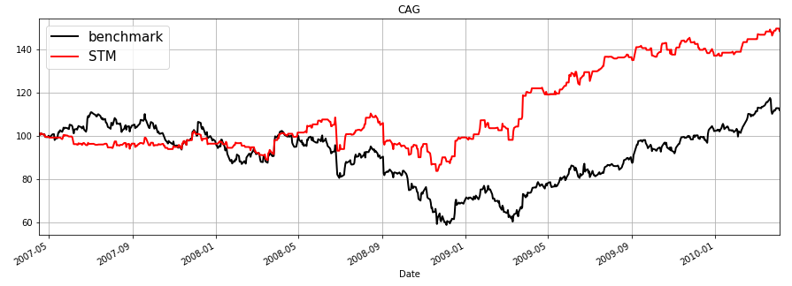
Support Tensor Machine
Hypothesis:
Added tensor dimensionality increases predictive power
Graph cluster-based multi-linear STM (accuracy 53.5%)

Slide 11
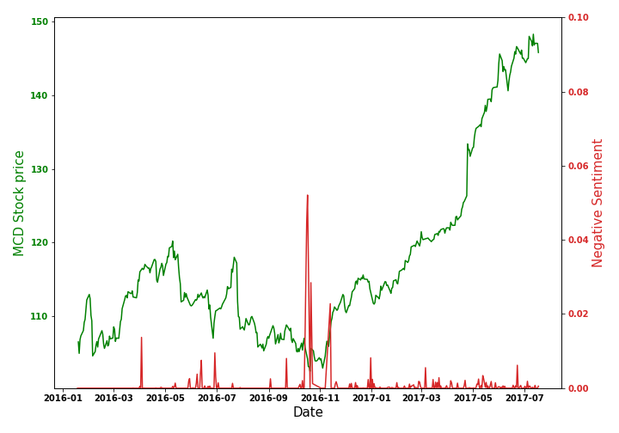

Sentiment Analysis
Hypothesis:
Social media posts can promptly capture shock events
Find daily post with most reactions
Calculate ratio of negative to positive reactions:
$$\frac{\# of ′sad′+\# of ′angry′}{\# of ′like′+\# of ′haha′+\# of ′love′}$$
Identify potential significant falls in return
Run daily with minimal computational cost

Slide 12
Thank You
Questions?

